Slide 1


Preparing for the Digital Age: Accountants’ Evolving Role and Changing Competencies
Raef Lawson, PhD, CFA, CMA, CSCA, CPA, CAE
Vice President-Research & Policy, Professor-in-Residence
Accounting Educator Conference
Kansas City, MO March 1, 2019

Slide 2
Agenda
Introduction
The Value Chain Goes Digital
The Changing Role of Accountants
Evolving Competencies for Accountants
The Call-to-Action

Slide 3
About IMA
IMA® (Institute of Management Accountants) is the worldwide association of accountants and financial professionals in business. Founded in 1919, we are one of the largest and most respected associations focused exclusively on advancing the management accounting profession.
We are committed to:
Empowering our 100,000+ members
Supporting our 300 professional chapters
Nurturing our 150 student chapters
Providing continuing education opportunities to our 27,000 active CMAs
Growing our footprint globally with a presence in 140 countries

Slide 4

The Value Chain Goes Digital

Slide 5
The Value Chain Goes Digital
Companies are encountering an industrial revolution in which companies use digitization to orient themselves to customers through e-commerce, digital marketing, social media, and the customer experience.
New business models are being developed today based on a connection to “information.”
Digitization is eliminating functional silos, and value chains are becoming integrated ecosystems that are fully transparent to everyone.
Notes:
Industry 4.0

Slide 6















Notes:
Technology is changing how we live and work – are you ready?
Some examples of AI and the changing business reality.
Watson can continuously learn like a human, using both structured and unstructured data, and it never stops learning. Medtronic is using it to help patients better manage their diabetes, Kia is using it to better identify the most influential social media sites for its cars, and Woodside Oil and Gas is using it improve operational efficiency. Absorbing vast amounts of data, learning, and providing recommendations…
Alexa, Amazon’s personal digital assistant, is changing how we interact with our home and how we shop…
Driverless cars are here…construction sites, factories, and soon on the roads.. Much safer actually.
Uber-ization of the economy and workforce… a platform, rather than linear business model, connecting user with service provider.
Other: BlackRock is using AI to pick stocks. There are Chatbots that give tax advice...and many more examples…

Slide 7
A Wave of New Technologies
An IMA research study¹ identified 10 technologies that will reshape the business landscape:
Mobile
Big Data
Artificial intelligence (AI) and robotic process automation (RPA)
Cybersecurity
Educational technologies
Cloud
Payment systems
Virtual and augmented reality
Digital delivery systems
Social media
Other studies have identify additional technologies (including the Internet of Things, blockchain, 3D printing, and drones) that will also radically alter how business is conducted.
¹ACCA-IMA, “Digital Darwinism: Thriving in the Face of Technology Change,” October 2013, www.accaglobal.com/content/dam/acca/global/PDF-technical/futures/pol-afa-tt2.pdf.

Slide 8
AI and RPA
Our research notes the following potential benefits to business from adopting AI and RPA (robotics process automation):
automating routine, repetitive, and labor-intensive tasks and processes,
reducing operating costs and increasing efficiency,
providing 24/7 service via myriad fixed and mobile devices,
developing innovative new products and services,
ensuring that products and services meet customer needs,
scaling up operations with fewer and cheaper resources, and
extracting more value from existing investments in technology.
¹ACCA-IMA, “Digital Darwinism: Thriving in the Face of Technology Change,” October 2013, www.accaglobal.com/content/dam/acca/global/PDF-technical/futures/pol-afa-tt2.pdf.

Slide 9

The Internet of Things
Connecting any device with an on and off switch to the Internet
Example: Haier’s Smart Fridge
Ability to collect vast amounts data
Ubiquity of data: Big Data
Leverage data to create value, new business models
Notes:
Analyzing Big Data can reveal patterns relating to human behavior
This data can be a strategic asset if the right tools are used in a disciplined way to unlock the information. This data can create value for the organization.

Slide 10


CLICK HERE TO VIEW
Source: CGP Grey, August 2014

Slide 11

The Changing Role of Accountants

Slide 12



What Does the Future Hold?
Accounting Today, November 2018
The Wall Street Journal, September 2018
CPA Trendlines, December 2018

Slide 13
It’s Crunch Time for Accounting
Both the accounting and auditing functions are experiencing a major wave of automation that most likely will result in substantive reduction of staff.
Li Zhang, Duo Pei, and Miklos A. Vasarhelyi, “Toward a New Business Reporting Model,” Journal of Emerging Technologies in Accounting, Fall 2017, http://bit.ly/2odcUgD

Slide 14
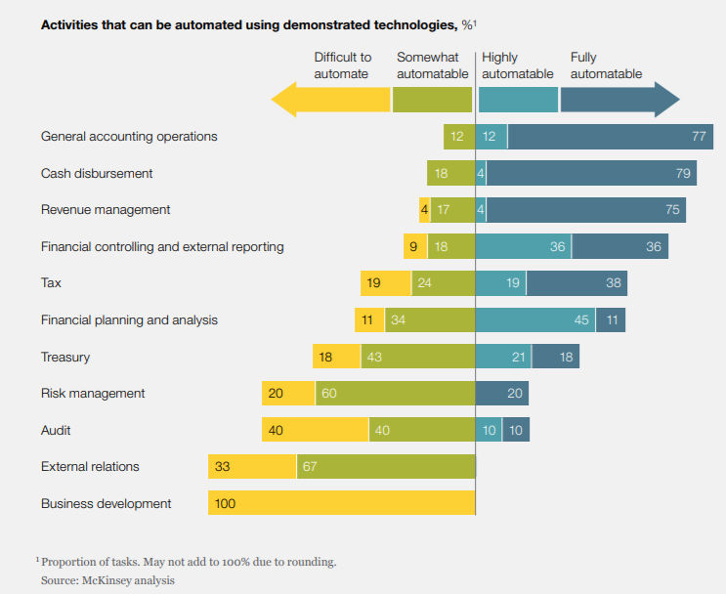
Transactional Activities Most Automatable

Slide 15

The CFO Team of the Past
In the past, the CFO team
was largely focused on:
Protecting value (value stewardship)
Oversight and Hindsight
Reporting, standards, and compliance

Slide 16

The CFO Team Today
Today, the CFO team has evolved to include:
Value creation
Insight and foresight
Role as business partner, including strategy, IT, operations, and data analytics

Slide 17
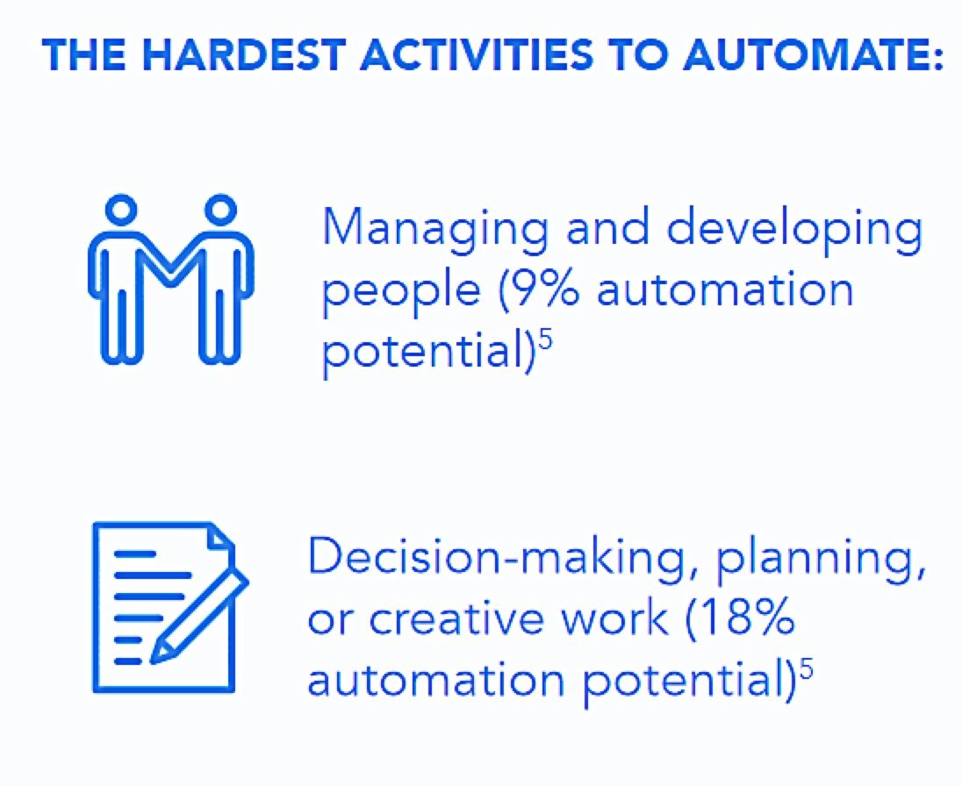
Robots Can’t Do Everything
Source: “Where machines could replace humans-and where they can’t (yet),” McKinsey & Company, July 2016

Slide 18


Evolve or Get Left Behind
“I’ll let the IT department handle implementing a more advanced data analytics function. It’s not my job.”
“I’m taking CPE courses in data analytics and working with IT and senior management on implementing advanced data analytics to inform decision-making.”
“I’m taking an advanced analytics course and working with IT and senior management on implementing a data analytics function.”

Slide 19
Everyone Must Pivot to Technology
Digital Natives
High stakes pursuit of higher education
Dual degree programs or electives in data analytics, computer science recommended
Graduating into a competitive job market
Like to be “mentored” vs. “managed”
Open to tech for process improvement
Gen Z
(under 21)
Gen Y
(ages 21 to 33)
Gen X
(ages 34 to 53)
Boomers (ages 54 to 70)
Executive leadership or individual contributor
Leading digital transformation efforts
Need to improve tech skills for credibility
May be occupying middle management roles
More tech skills will enable them to move up within their organization or pursue freelance, independent work

Slide 20
The Accountant as Business Partner¹
The essential role of accountants is and will continue to be value creation.
Accounting’s value proposition can be defined in terms of strategy formulation and analysis, planning, and execution.
Accountants must move up the value-chain, performing higher value-added work
¹“Focusing Accounting Curricula on Students’ Long-Run Careers: Recommendations for an Integrated Competency-Based Framework for Accounting Education”, Raef Lawson, Edward Blocher, Peter C. Brewer, Gary Cokins, James E. Sorensen, David E. Stout, Gary L. Sundem, Susan K. Wolcott and Marc J. F. Wouters), Issues in Accounting Education, May 2014.
Notes:
Accounting and finance professionals need the skills for required for:
providing enhanced reporting of risk exposures,
reporting information to inform decisions on deploying capital to grow the business profitably,
supporting long-term value creation, and
communicating the ways in which accounting can promote organizational success.

Slide 21


Four Roles for Today’s Accountants
Steward
(26%)
Operator
(37%)
Catalyst
(20%)
Strategist
(17%)
Source: Enterprise Performance Management and the Role of the Management Accountant in India, 2018
Notes:
Today’s CFO Team has 4 “lines of sight”
Oversight is a more traditional CFO role in terms of financial performance and monitoring; for example, company’s balance sheet and cash flow. Insight is truly where business partnering begins and business analytics takes over. Reporting the numbers is vitally important, but turning information into intelligence and ultimately insight is what often distinguishes good companies from great ones. Perhaps the most important of the four sights is foresight, when CFOs play a leading role in anticipating the future, building an adaptable mindset, and helping their organizations envision a great future. Hindsight means looking back at history to influence the future in a positive way, using historical data for future projections of cash flow, for example.
The Finance Team is charged with both preserving value and creating value. Senior financial leaders increasingly need to apply their analytical and business skills to more strategically oriented organizational issues, increasing the value that they provide to their organizations. They increasingly need to form business partner relationships with operational areas to provide and use both financial and nonfinancial data to make better business decisions.
Data analytics can help unlock that value…

Slide 22
The Evolving Role of the Accountant as a Trusted Business Advisor
ACCA-IMA, “The Future CFO Role,” November 2014

Slide 23
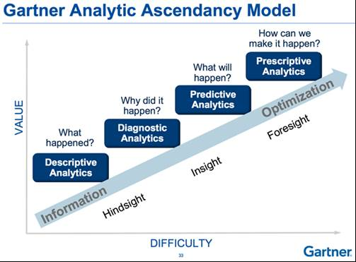
Data Analytics Evolution
Source: Gartner Inc., as published in Strategic Finance, Tech Practices, January 2015
Notes:
Here’s a chart created by Gartner that shows the evolution of data analytics: from descriptive analytics, to diagnostic, to predictive, to prescriptive. Note the “lines of sight” of hindsight, insight, and foresight.
Management Accountants are already doing data analytics. But traditional analytics: profitability analysis , cash flow, return on assets, tell a limited story.
Need Augmented data analytics.
Descriptive: what happened/Diagnostic: Why
Predictive- uses statistical analysis, data modeling, real time input, real time value scoring and machine learning to detect trends for forecasting
Prescriptive – rank the trade offs of different courses of action; e.g. scenario modeling/ optimization algorithms; what you should do
Underlying assumptions: will gain competitive advantage if we can anticipate the future better

Slide 24
An Emerging Role - Analytics Translator
Data scientists can serve as valuable support for finance professionals, making it possible to derive recommendations for action from large quantities of unstructured data.
Finance and accounting professionals must learn to communicate with data scientists and technology specialists, helping to translate data into business insights.
This role has been described as being that of an analytics translator

Slide 25
Evolving Competencies for Accountants

Slide 26
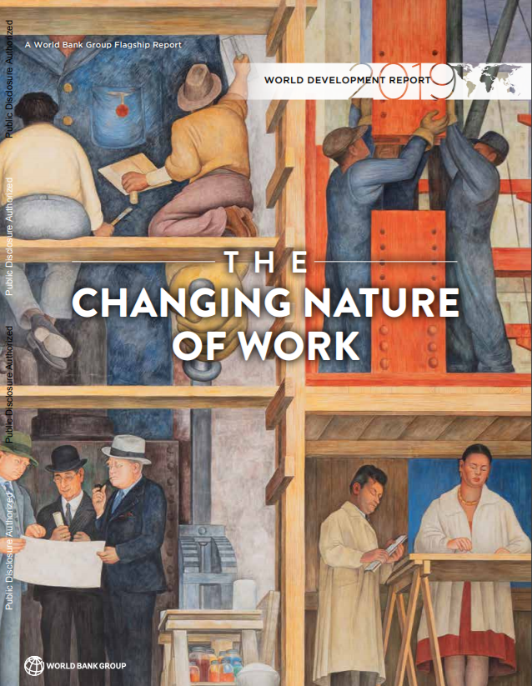
Preparing for the Future of Work
No simple or prescriptive solutions
Many jobs today, and many more in the near future, will require specific skills - a combination of technological know-how, problem-solving, and critical thinking - as well as soft skills such as perseverance, collaboration, and empathy
Source: “The Changing Nature of Work” World Bank Group, 2019

Slide 27

It’s Crunch Time for Accounting
“
Employees will be doing things in new ways, some of which will make CFOs uncomfortable. Finance talent models are evolving quickly, with a premium placed on data scientists, business analysts, and storytellers. All of your people should be able to contribute to elevating the value of Finance in terms of communication, impact, and influence. Make every new hire count.
- Deloitte’s “Crunch Time V, Finance 2025”

Slide 28
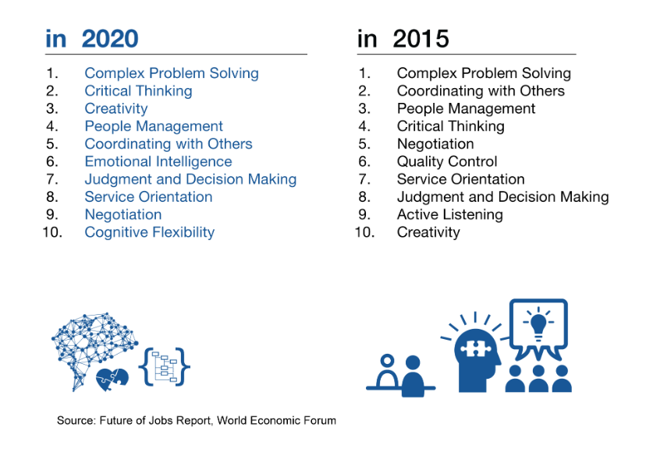
Top 10 Skills Employers Want
https://www.weforum.org/agenda/2016/01/the-10-skills-you-need-to-thrive-in-the-fourth-industrial-revolution/

Slide 29
The Skills Gap
Nontechnical Skills
Decision analysis (37%)
Process improvement (35%)
Strategic thinking and execution (32%)
Adaptability to change (31%)
Communication skills (29%)
Leadership (28%)
Problem solving (27%)
Relationship building (19%)
Industry knowledge (15%)
Technical Skills
Identify key data trends (29%)
Operational analysis (28%)
Data mining and extraction (28%)
Technological acumen (27%)
Statistical modelling & data analysis (26%)
Planning, budgeting, & forecasting (22%)
ERP systems (21%)
Cost management (20%)
Financial analysis (18%)
Source: IMA-RobertHalf study, 2018.

Slide 30
Challenges and Opportunities for Accountants
Accountants don’t have to be data scientists or applied mathematicians
We do need to be able to ask the right questions
We do need competence in regression, correlation, segmentation analysis and other analytical techniques
We need to be able to work with AI – augmented intelligence
Accountants can serve as the link between the experts and business leaders
Notes:
As I said earlier, management accountants are already doing data analytics. Management accountants leverage data to generate insight to drive value.
Management accountants play an important role in defining the business problem to be solved, selecting the right tools to use, using and explaining the tools, interpreting the results, ensuring the integrity of the data, testing the reliability, validity, and reasonableness of the results, and making and/or implementing the decisions. And, very importantly, communication.
Management accountants don’t have to be data scientists, but do need to be able to ask the right q’s of data scientists, and work with Augmented Intelligence;
Partner with data science experts to communicate recommendations to senior business leaders.
You don’t need to be a statistician, but you should build some competence in regression, correlation, and segmentation analysis, as well as data governance.

Slide 31
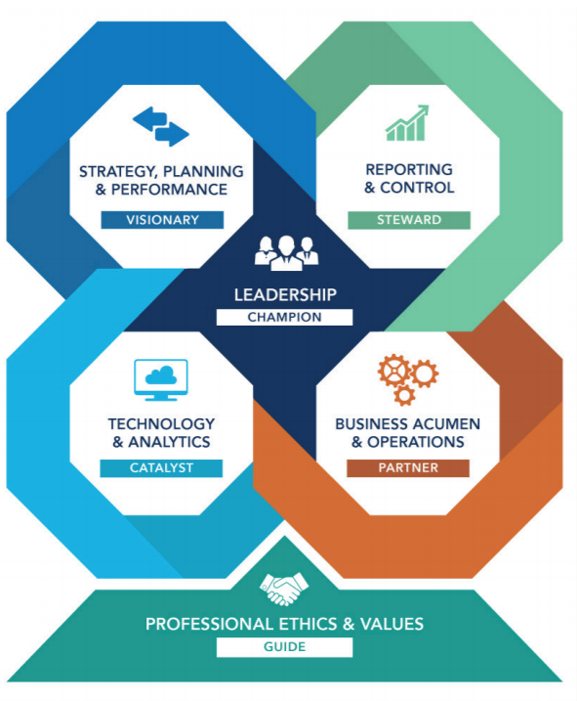
IMA’s Updated Management Accounting Competency Framework
Accounting & finance professionals need to be able to see the organization as a whole and develop the analytical and integrated thinking skills necessary for value creation.
Notes:
This is a snapshot of the 6 domains in the IMA Management Accounting Competency Framework.
Management Accountants drive value along the entire value chain. Data analytic skills can enhance the business insight required to create value and competitive advantage.
31

Slide 32
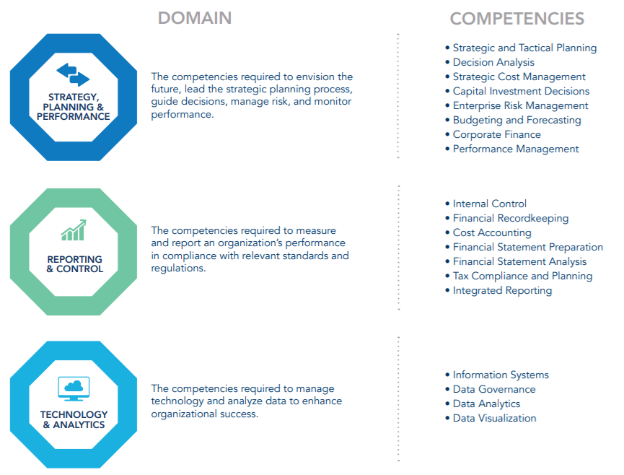
Competencies by Domain

Slide 33
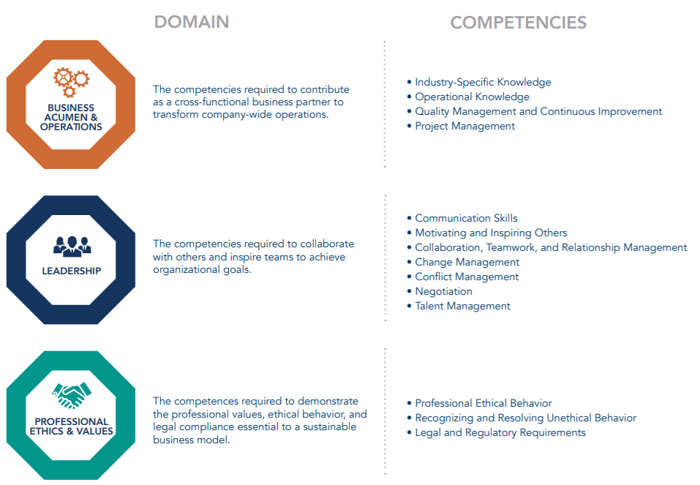
Competencies by Domain

Slide 34
The Call-to-Action

Slide 35
Relevance Lost or Relevance Gained in the Digital Age?
Automation has been around for a long time. This time, it is different.
Our profession can become MORE or LESS relevant in the face of digitization (AI, robotics, intelligent process automation) based on how urgently we focus on building COMPETENCY and TALENT; technology is secondary
The entire professional ecosystem must UPSKILL in strategy management and data science

Slide 36

The Call-to-Action
For individuals – Adopt and adapt to skills in artificial intelligence, robotics, and intelligent process automation. Upskill!!
For academia – Raise the stakes in better aligning what is taught vs. what today’s “accountants” actually do.
For corporations – Tone at the top in embracing data analytics as the new science of winning in a competitive age full of disruption.
For accounting associations – Be part of the solution by advancing competency with training and education.

Slide 37
Accounting firms & Companies
Accounting firms and Organizations’ finance functions must:
Assess and prioritize tasks and processes for automation,
Identify the areas most likely to be “de-skilled” or commoditized,
Develop new skills to take advantage of the potential to focus on higher-value tasks and services, and
Develop new ways to communicate and measure value and success, including advanced data analytics (moving beyond descriptive statistics to predictive and prescriptive analytics), data visualization, and “storytelling.”

Slide 38
Practitioners - Preparing for the Future
Develop an appropriate (data-oriented) mind-set.
Develop enhanced communication and relationship-management skills.
Develop the ability to think critically.
Develop strategic management/thinking skills.
Develop enhanced risk management skills.
Focus more on innovation and change management.
Develop skills in data analytics.
Consider obtaining a professional certification.

Slide 39
Questions for Accounting Educators
To what extent does my school’s curriculum prepare students for long-term career success?
Does my school’s curriculum reflect the business-partnering role of accountants?
To what extent does my curriculum cover essential technological skills?
To what extent is professional ethics integrated into my curriculum?
Interpersonal and Communication skills will be increasingly important. Is my school rethinking its coverage of these competencies in my curriculum?

Slide 40
Questions for Accounting Educators
To what extent do my curriculum and instructional methodologies foster the development of higher-order learning skills?
Does my curriculum help students develop competencies in an integrated manner?
Do my school’s business model and course offerings reflect the changing education landscape?

Slide 41

IMA Educational Resources
IMA’s new Technology & Analytics Center
Contains a wide variety of resources, including articles, research reports, and webinars
Examples:
New research report, “Management Accounting Competencies: Fit for Purpose in a Digital Age?” (May 2018)¹
Excel Data analytics online course (July 2018)
Tech Talk Webinars
  Data Analytics (July 2018)
  Data Visualization (September 2018)
Strategic Finance articles:
  “How to Master Digital Age Competencies” (September 2018)

Slide 42


Questions?
Raef Lawson
RLawson@imanet.org
201-474-1532

